Slide 1
Module 2: High-Level Modeling
Computational Thinking II
Present By: Tolu Adeola, Maloney Tutu, Earl Pough, and Ralph Reyes

Slide 2
Overview
In the previous module, we developed the SIIZR model, a variation of the SIR model, and included an additional category, Intelligent Zombie. In this current module, we will implement UML and present the Class Diagram, State Machine Diagrams, and Activity Diagram to further describe our SIIZR model.

Slide 3
Our Approach
First Step: Identifying the Main Components
Susceptible
Infected
Intelligent Zombie
Removed
Second Step: Focusing on One Diagram at a Time
We worked on each diagram as a group
Constantly referred back to the presentation slides and given sources
Third Step: Implementing the Diagrams
Held meetings to get feedback from every team member
Revised the diagrams iteratively to best fit our needs

Slide 4
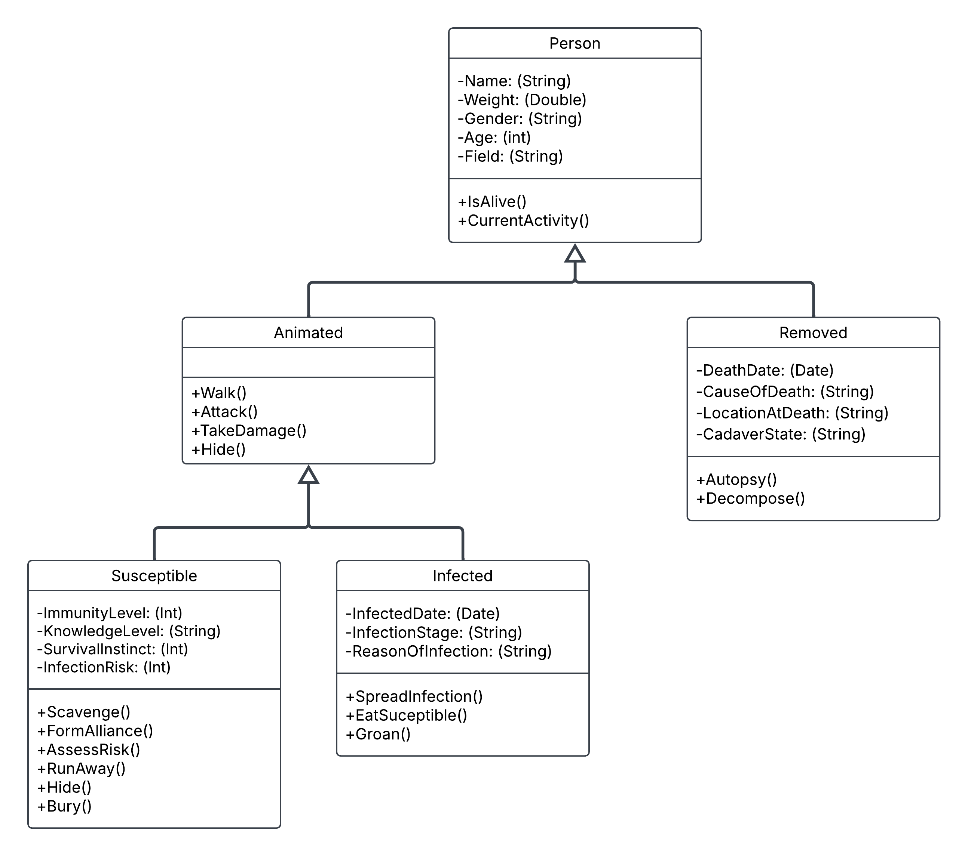
Class
Diagram

Slide 5
Class
Diagram

Slide 6
Class
Diagram

Slide 7
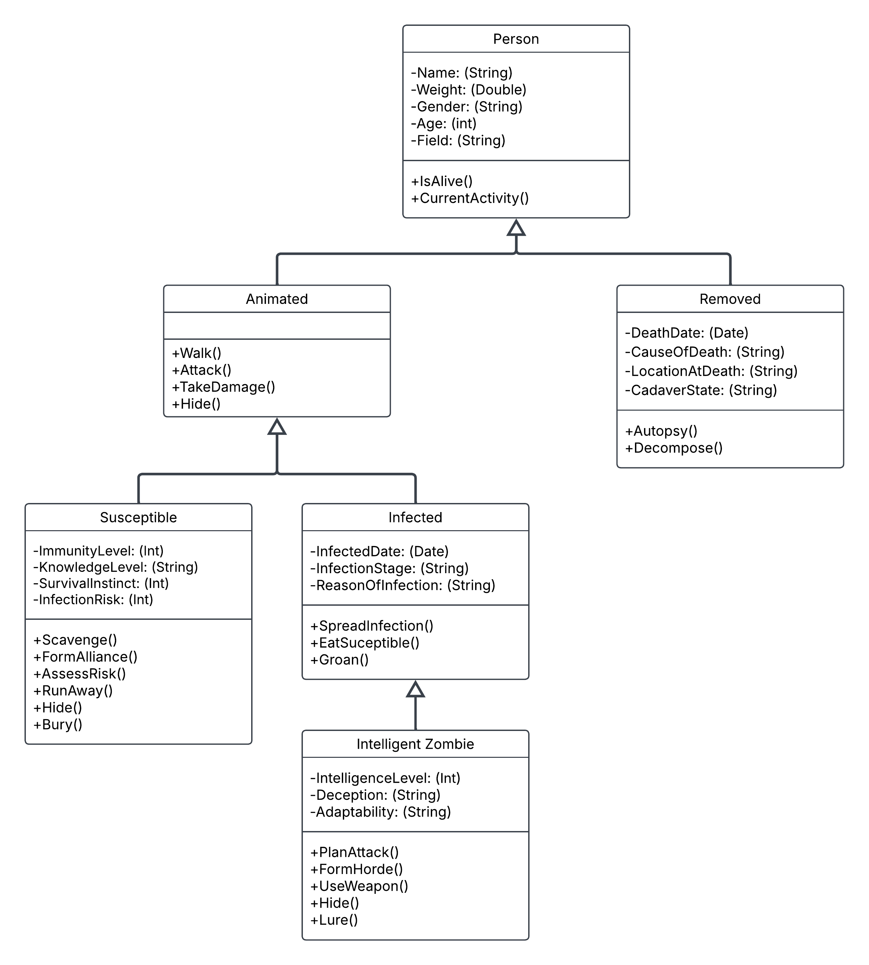
Class
Diagram

Slide 8
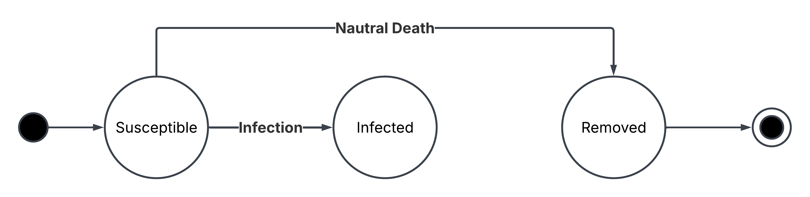
State Machine Diagram

Slide 9
State Machine Diagram

Slide 10
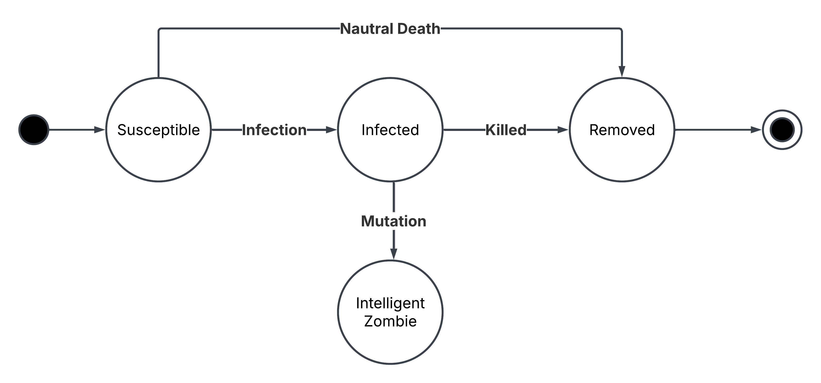
State Machine Diagram

Slide 11

State Machine Diagram

Slide 12
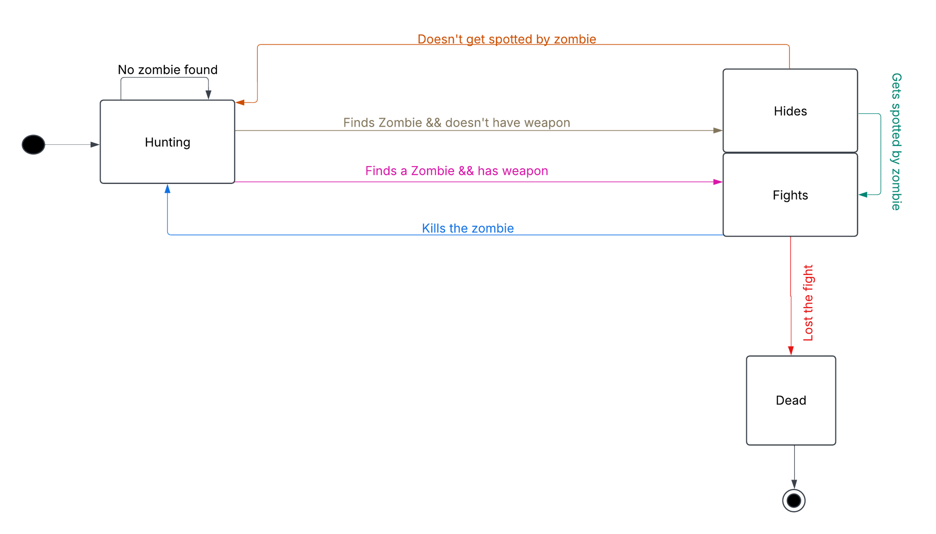
State Machine Diagram- Suspectable

Slide 13
State Machine Diagram- Suspectable

Slide 14
State Machine Diagram- Suspectable

Slide 15
State Machine Diagram- Suspectable

Slide 16
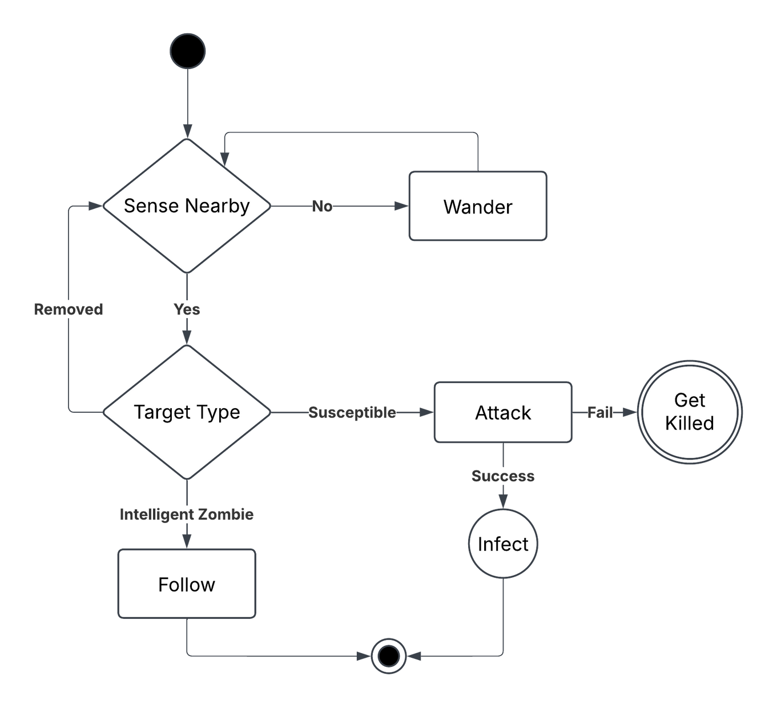
Activity Diagram - Infected

Slide 17
Activity Diagram - Infected

Slide 18
Activity Diagram - Infected

Slide 19
Activity Diagram - Infected

Slide 20
Activity Diagram - Infected

Slide 21
Activity Diagram - Infected

Slide 22
Activity Diagram - Infected

Slide 23
Activity Diagram - Infected

Slide 24
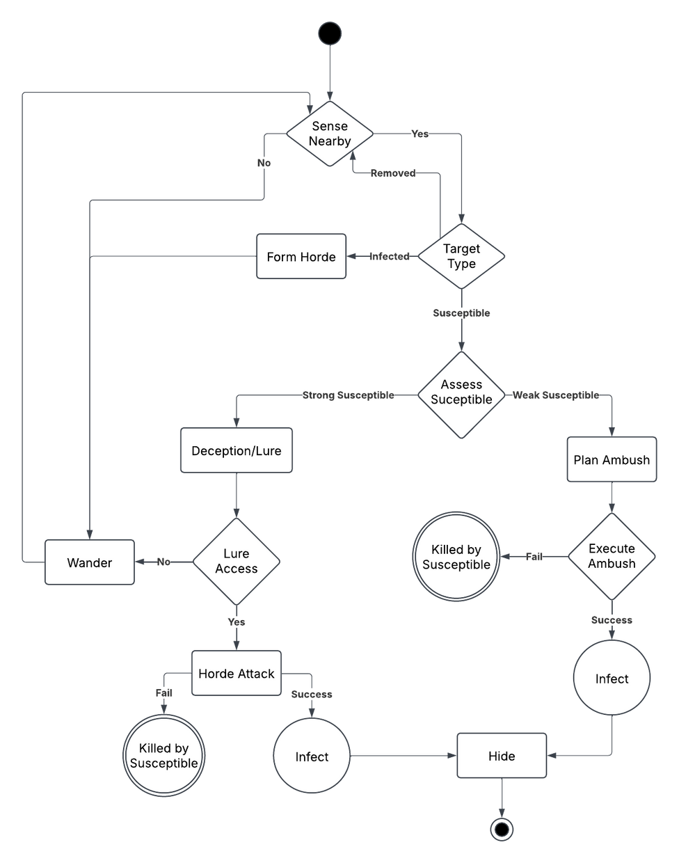
Activity Diagram - Intelligent Zombie

Slide 25
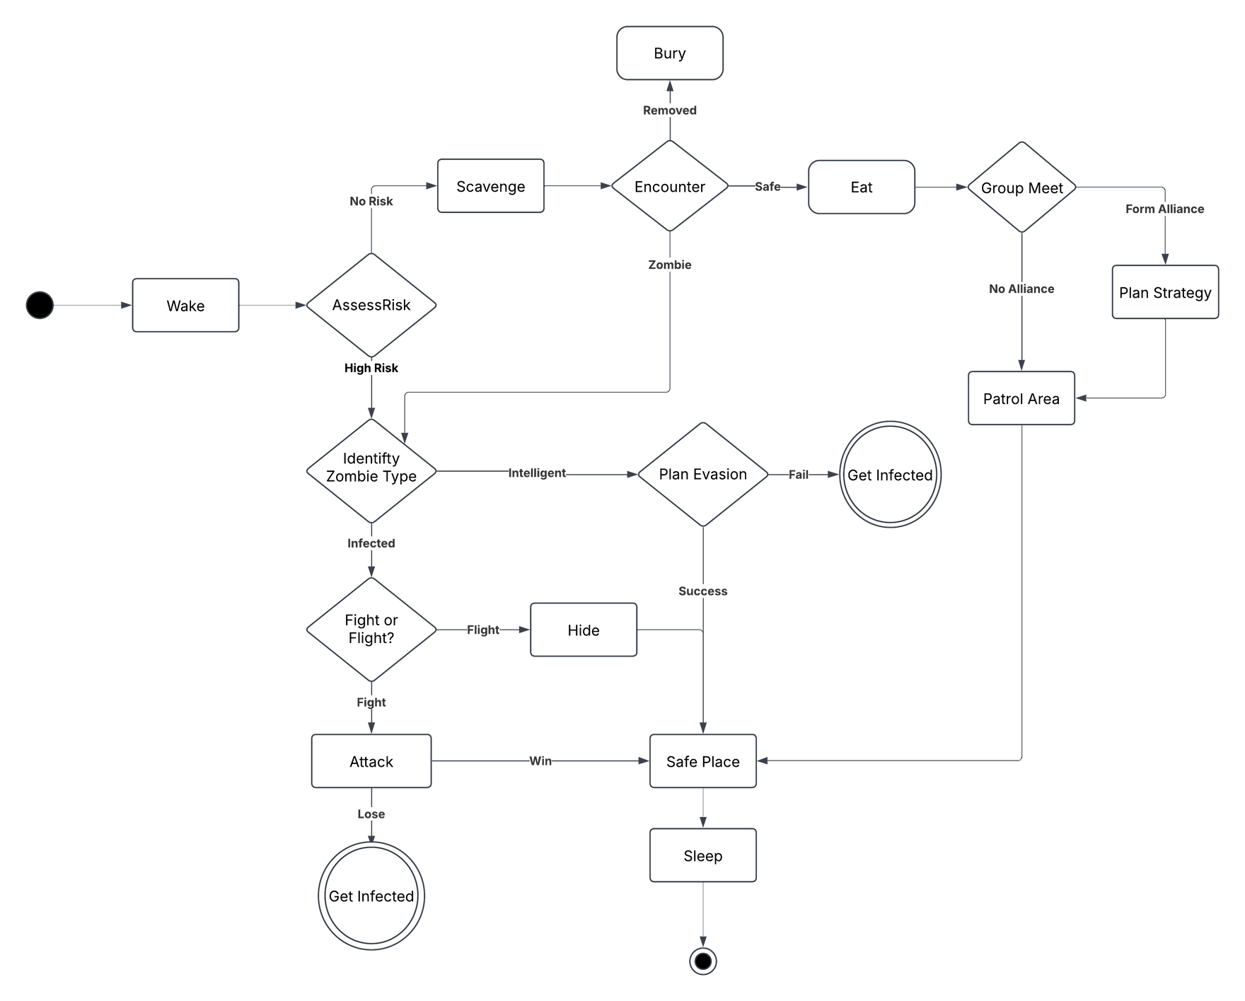
Activity Diagram - Susceptible

Slide 26
Main Challenge
Other Activity Diagrams
We faced a challenge in creating Activity Diagrams for the other sub-populations beyond the Infected sub-population. Although optional, we decided to complete these diagrams as well, as we believed it would benefit us in the long run, while we are at the peak of our knowledge. This was taken to avoid the risk of forgetting important components if we had waited at the end of the semester to create the additional diagrams.

Slide 27
Thank
You

